Slide 1

Classifying Human Physical Activity Sequential Sensor Data Using Neural Networks
March 11, 2026
Owusu Boakye Gideon, Jessie Tian, and Urim Iyasere

Slide 2

Introduction and Research Questions
Background
Mobile health (mHealth) technologies have been increasingly utilised to improve remote monitoring, preventative care, and patient engagement.
Accurate prediction of human exercise and activity levels can improve personalised fitness tracking and population-level public health monitoring
Sample: 9 healthy participants, >18 y.o.
Label: Activity levels (0-12)
Features: Accelerometer (left ankle, lower arm) and gyroscope metrics
Can a sequential neural network accurately predict and discriminate human activity levels using wearable sensor readings?

Slide 3



Data engineering and modelling
Data Cleaning
Checking missing data and outliers
Dropped subject 9 for high degree of missing activity information from 3-12
Dropped activity 0 (“nothing”) due to lack of clinical meaning and large class imbalance
Preparation
Data splitting by subject: 80% training, 20% test
Rolling window sequence generation:
window size = 200, stride = 100
Resulting groupings:
Training: (2650, 200, 12)
Test: (675, 200, 12)
Modeling
3 hidden layers
Adam optimiser
Cross-entropy loss function
Activation function
ReLU(hidden)
Softmax (output)
Dropout layers (0.5, 0.2)
Early stopping: patience = 10
Performance on accuracy and F1-scores
RNN
Hidden nodes: 64
Epoch: 100
Learning Rate: 0.0001
Batch Size: 128
LSTM
Hidden nodes: 64
Epoch: 100
Learning Rate: 0.001
Batch Size: 512

Slide 4
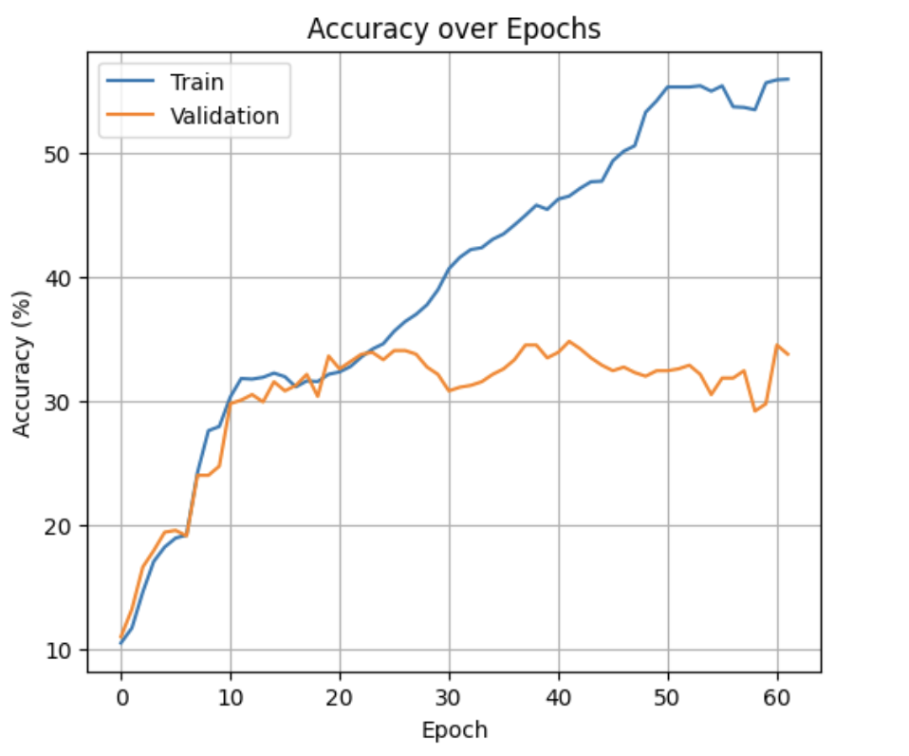
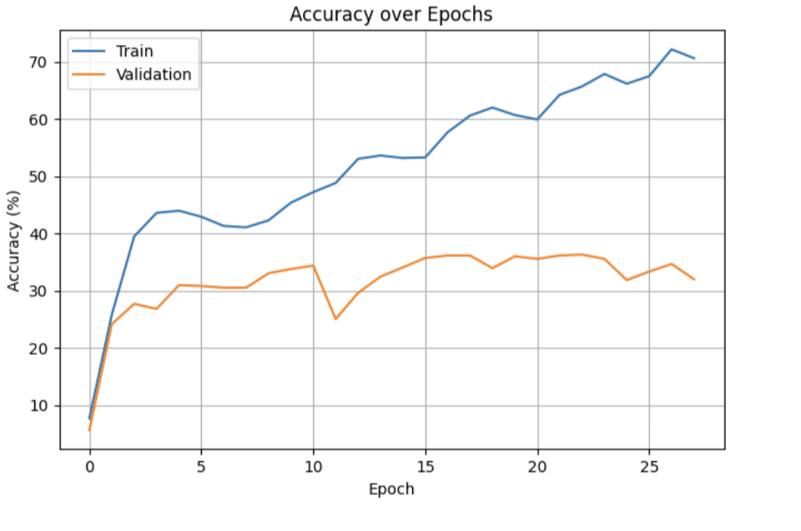
Findings
RNN
Model performance metrics evaluated on test set
Model | Epoch (early stop) | Accuracy | F1 Score
RNN | 62 | 0.3259 | 0.2309
LSTM | 28 | 0.3615 | 0.3039
Overfitting for both NN → limited generalisability on unseen data
LSTM outperforms by accuracy and F1-score
robust to long sequences
Recall and precision was 0 for several features
Limitations
Complex multiclassification prediction task more prone to misclassifying
Limited generalisability to healthy patients
Computational limitations for cross-validation and hyperparameter tuning
LSTM
Future directions:
Re-encoding activities and simplify classification tasks with larger categories

